Slide 1
Professional Personality Attributes

Slide 2

Introduction
Generally people learn to teach a language with main purpose of being able to communicate with speaker of that language.
For direct interaction oral medium is used .
A speaker’s style can be formal or informal depending on the context.

Slide 3

Definition
Personality means how people affect others, how they understand and view themselves, as well as their inner and outer measurable traits.
It primarily depends on their professional attributes and their values towards life.

Slide 4
Professional Personality Attributes
People have to communicate with various sorts of people while working in an organisation
Exchange of ideas takes place through oral or written forms of communication.
Well developed aspects of personality play a vital role in determineing overall professional success.
Below is list of professional attributes of personality

Slide 5

Professional Personality Attributes
Empathy
Considerateness
Leadership
Competence
Assertiveness
Postive Attitude

Slide 6

Empathy
Empathy is the ability to emotionally understand what other people feel, see things from their point of view, and imagine yourself in their place. Essentially, it is putting yourself in someone else's position and feeling what they must be feeling
Having a great deal of empathy makes you concerned for the well-being and happiness of others. It also means, however, that you can sometimes get overwhelmed, burned out, or even overstimulated from always thinking about other people's emotions..

Slide 7
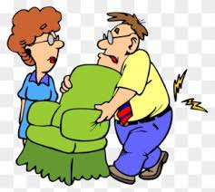
Considerateness
The civility of manners is a set of conventions that allows us, according to the philosopher Cheshire Calhoun, to “communicate basic moral attitudes of respect, tolerance and considerateness.”
It makes a professional caring so that the audience feel to be the part of their community and contribute positively.

Slide 8
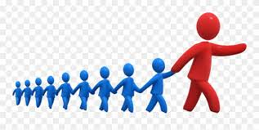
Leadership
Leadership is both a research area and a practical skill encompassing the ability of an individual, group or organization to "lead", influence or guide other individuals, teams, or entire organizations.
Leadership quality equips the speaker with courage to face the challenges which require energy and positivity.

Slide 9

Competence
Competence is the set of demonstrable characteristics and skills that enable and improve the efficiency or performance of a job. The term "competence" first appeared in an article authored by R.W. White in 1959 as a concept for performance motivation.
It refers to a quality of possessing required skill, knowledge, qualification or capacity.

Slide 10
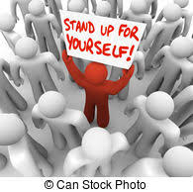
Assertiveness
Assertiveness is the quality of being self-assured and confident without being aggressive. In the field of psychology and psychotherapy, it is a skill that can be learned and a mode of communication.
It enables the speaker to think in a positive manner about himself as well as about others.
This positive attribute keeps him free from all tensions just because he is ready to interact with others and seek their cooperation.

Slide 11

Positive Attitude
It is the most important trait of a professional’s personality.
Your attitude to something is the way that you think and feel about it, especially when this shows in the way you behave.
If you are positive about things, you are hopeful and confident, and think of the good aspects of a situation rather than the bad ones.
It helps in reducing stress and seek other’s cooperation.

Slide 12
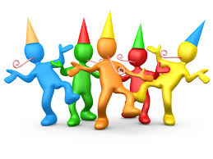
Team Spirit
Team spirit is the feeling of pride and loyalty that exists among the members of a team and that makes them want their team to do well or to be the best.
Team spirit is crucial to a work environment the stronger the team the stronger the company, by having strong team spirit among colleagues will boost motivation and will enable colleagues to feel a part of a team.

Slide 13

Adaptability
Being able to adapt to changing environments and work processes can be desirable traits to employers.
Having adaptability skills means you are open and willing to learn new things, take on new challenges and adjust suit transitions in the workplace.
Additionally, developing your adaptability can also mean developing other soft skills like communication and interpersonal skills.
Being adaptable in the workplace can be important when working on projects, developing strategies and implementing different approaches to doing your job. By showing your employers your adaptability skills, you are revealing how motivated you are to try new things and learn new skills.

Slide 14

Analytical Skills
Analytical skill is the ability to deconstruct information into smaller categories in order to draw conclusions.
Analytical skill consists of categories that include logical reasoning, critical thinking, communication, research, data analysis and creativity.
Analytical skill is taught in contemporary education with the intention of fostering the appropriate practices for future professions.
The professions that adopt analytical skill include educational institutions, public institutions, community organizations and industry.

Slide 15

Observational Skills
Our observation skills inform us about objects, events, attitudes and phenomena using one or more senses. Additionally, being able to observe and gather information about the world is important because it's the basis of communicating well.
Ways to sharpen the observation skills:
Increasing Your Awareness
Improving Your Memory
Engaging Your Senses

Slide 16

Conclusion
Finally, it is evident that one’s behaviour style plays an important part in social exchanges in in a social gathering as it governs interpersonal relationships upon which lies the success of an individual as a professional.
--------------------

